Slide 1
VISION-BASED INDUSTRIAL QUALITY INSPECTION
ITA0501-Computer Vision
Guided By
R.C .Jeni Gracia
Presented By
Deepa Preya H (192421047)
P . Sarmila (192524383)
Reshma B S (192521342)
Sumetha Sri S (192521097)

Slide 2
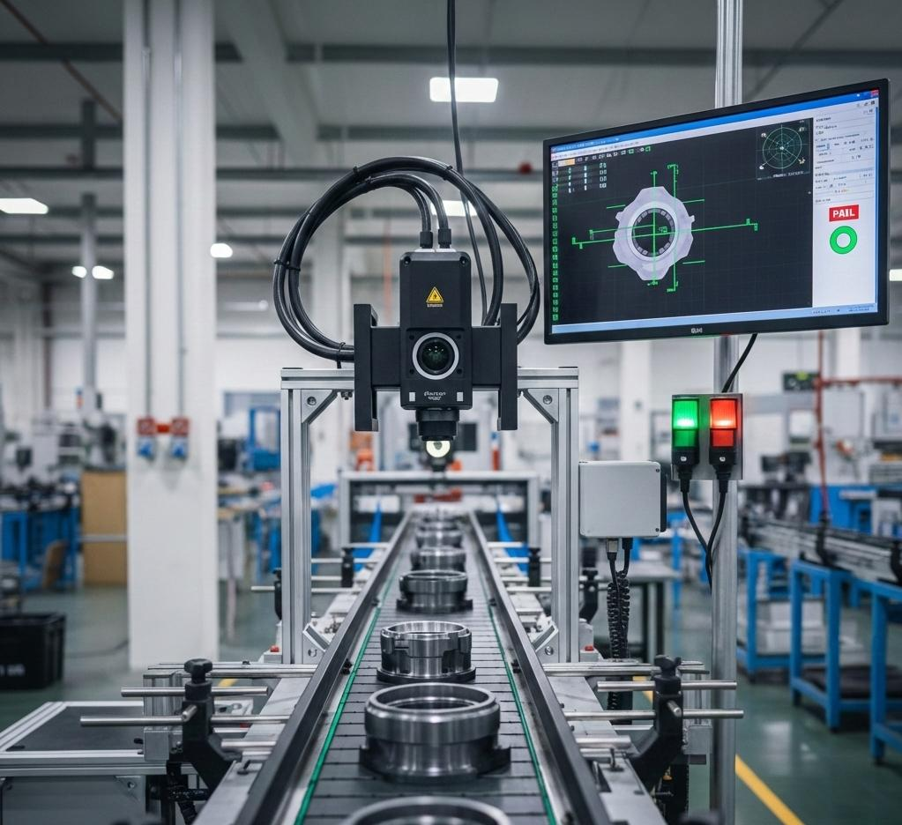

(A) CAMERA-BASED IMAGE ACQUISITION
Capturing the Product
Industrial cameras capture product images on the production line.
Controlled lighting helps reveal surface defects.
Camera position and resolution affect image quality.
Images are continuously captured for inspection.
Product
Camera
Image Capture
Computer

Slide 3
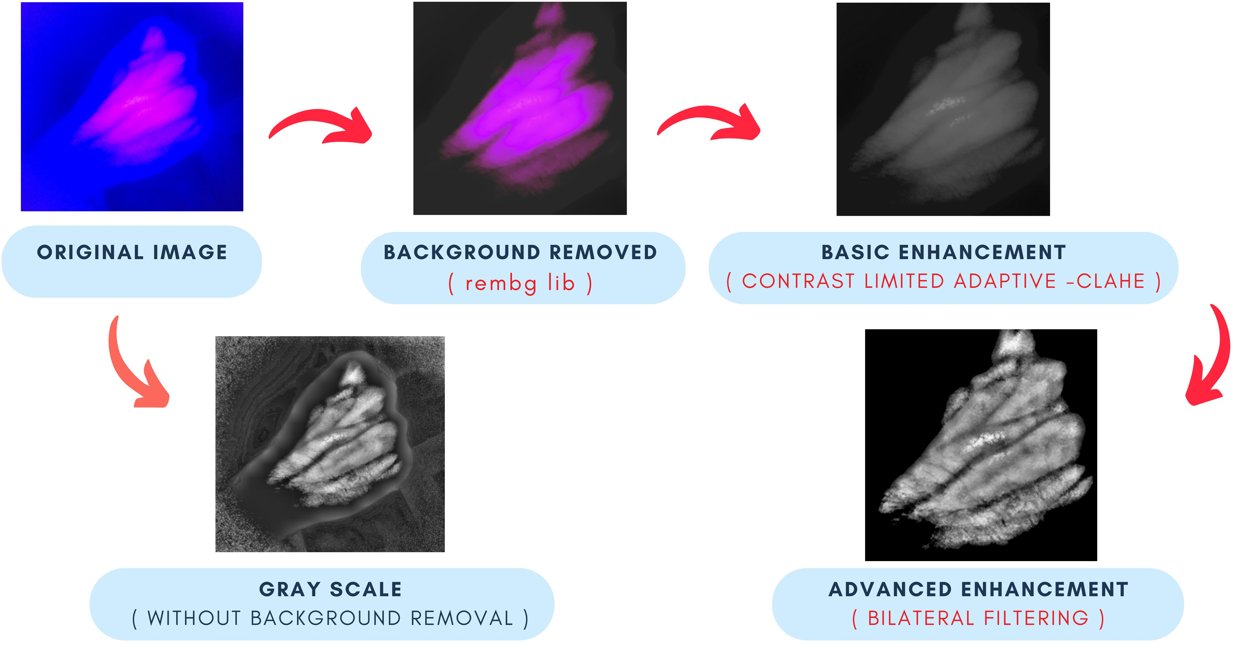
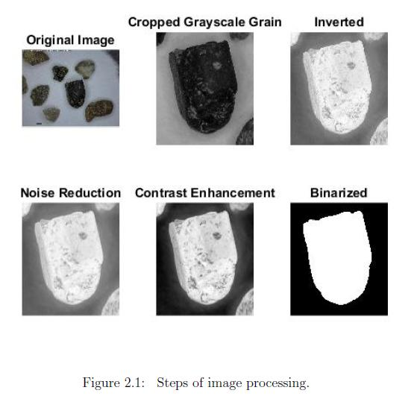
IMAGE PREPROCESSING
Preparing the Image for Inspection
Raw images may contain noise, unwanted background and uneven lighting.
Main operations:
Resize the image
Convert RGB → Grayscale
Remove noise
Adjust contrast
Normalize image intensity

Slide 4
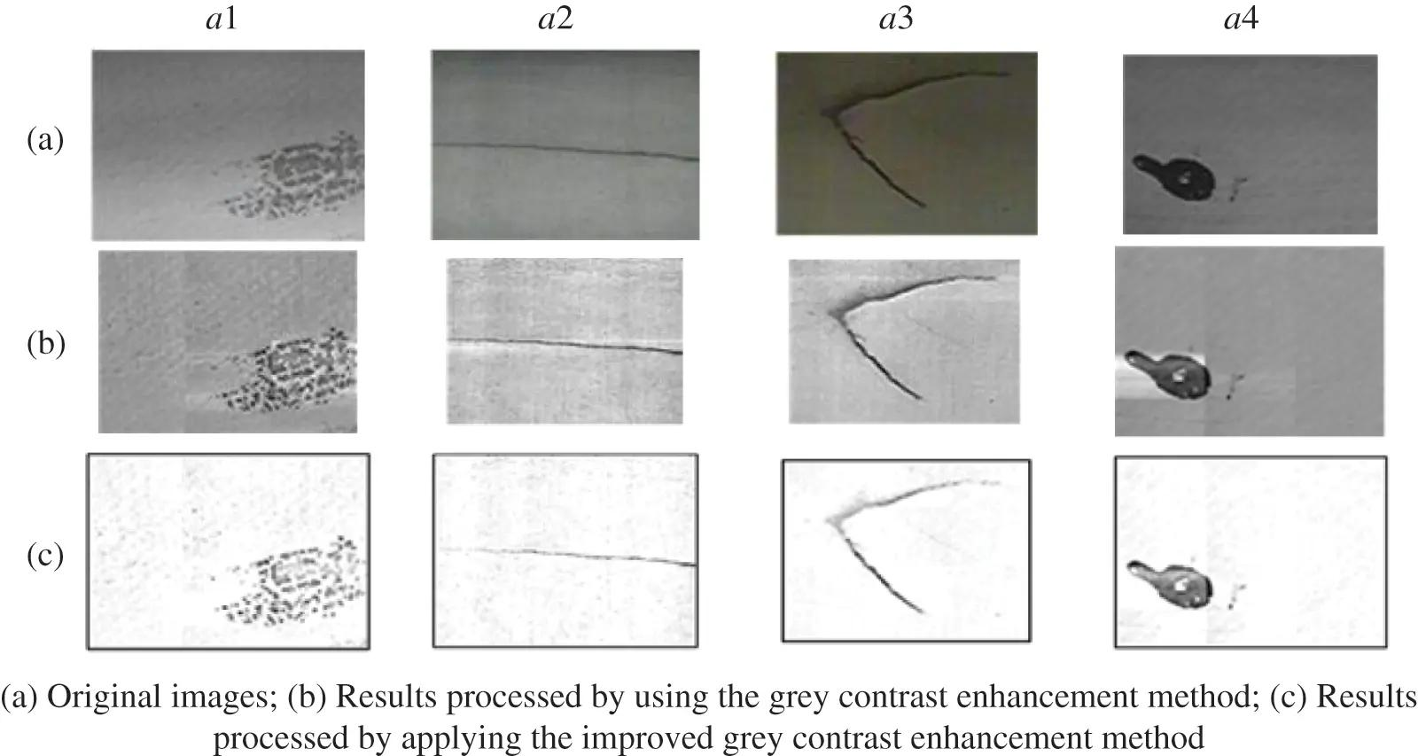
(B) IMAGE ENHANCEMENT & SPATIAL FILTERING
Improving Defect Visibility
Image enhancement makes small defects easier to identify.
Technique | Purpose
Gaussian Filter | Reduces noise
Median Filter | Removes unwanted noise
Histogram Equalization | Improves contrast
Sharpening | Highlights fine details

Slide 5
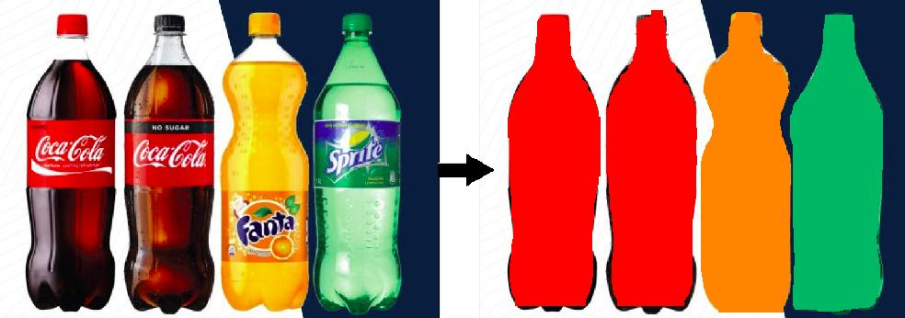

IMAGE SEGMENTATION
Isolating the Product Region
Segmentation separates the product from its background.
Common techniques:
Thresholding
Adaptive Thresholding
Binary Segmentation
Contour Detection
Image
Thresholding
Product Region
Defect Region

Slide 6
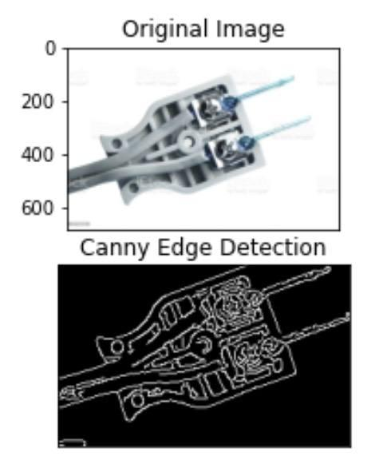


(C) EDGE & CORNER DETECTION
Image
Finding Important Product Boundaries?
Edge Detection
Detects sudden changes in image intensity.
Helps identify cracks, scratches and boundaries.
Canny Edge Detection is widely used in OpenCV.
Corner Detection
Finds important points where edges meet.
Helps check component position and shape.
Canny
Edges
Defect Identification

Slide 7
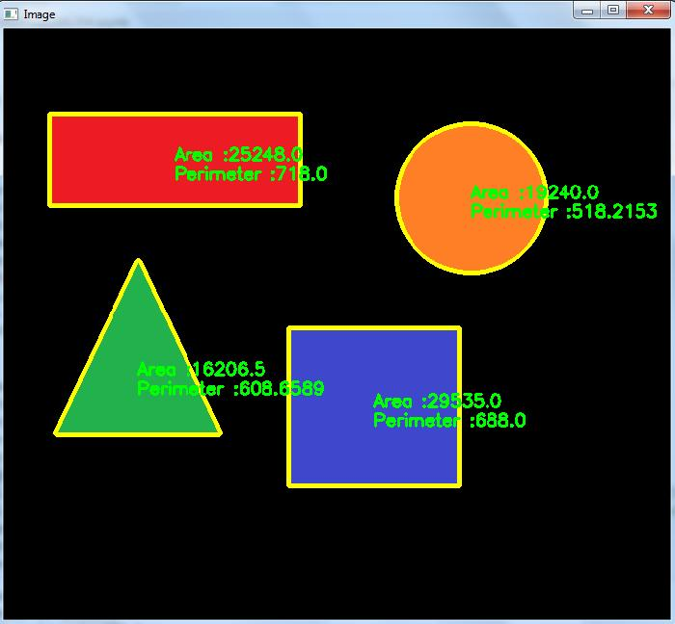
FEATURE EXTRACTION
Extracting Product Characteristics
The system extracts measurable features from the product image.
Important features:
Shape
Area
Perimeter
Size
Texture
Contours
Edge patterns

Slide 8
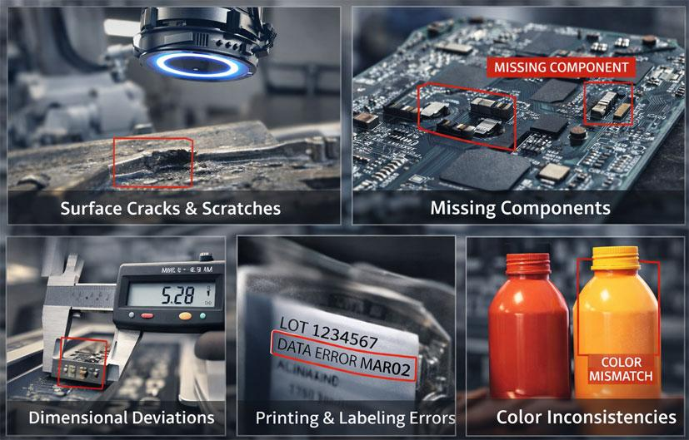
(D) PATTERN RECOGNITION
Recognizing Defect Patterns
Extracted features are compared with expected product patterns.
Normal products follow predefined characteristics.
Abnormal patterns indicate possible defects.
Pattern recognition helps classify products automatically.

Slide 9
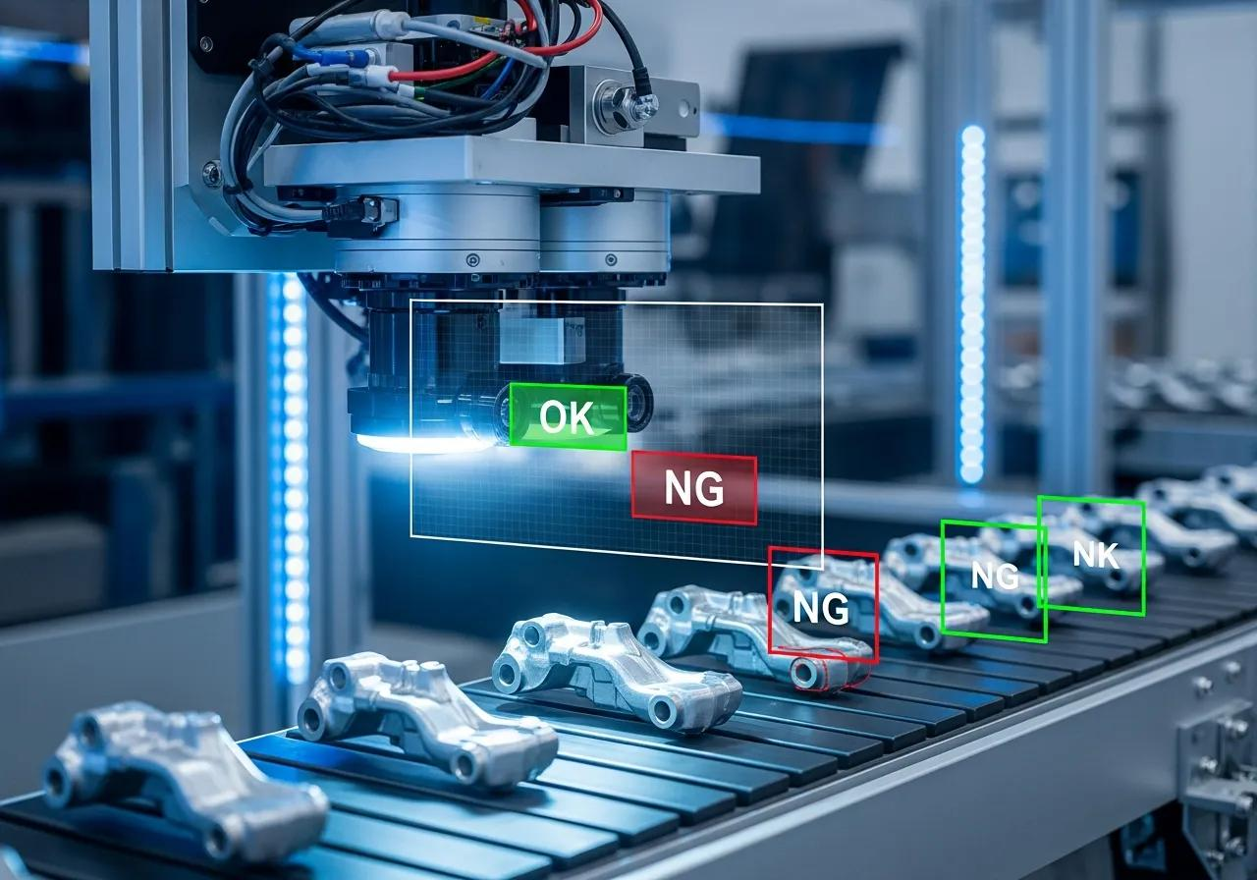
DEEP-LEARNING-BASED CLASSIFICATION
Using CNN for Defect Classification
Deep learning learns complex defect patterns from training images.
Training
Product Images → CNN → Feature Learning → Trained Model
Testing
New Product → CNN Model → Prediction
Example:
✅ Good Product
❌ Crack
❌ Scratch
❌ Missing Component

Slide 10



(E) OPENCV REAL-TIME INSPECTION
From Camera Feed to Automatic Inspection
OpenCV connects image acquisition and processing for real-time inspection.
Camera
Frame Capture
Preprocessing
Enhancement
Feature Detection
Segmentation
Classification

Slide 11
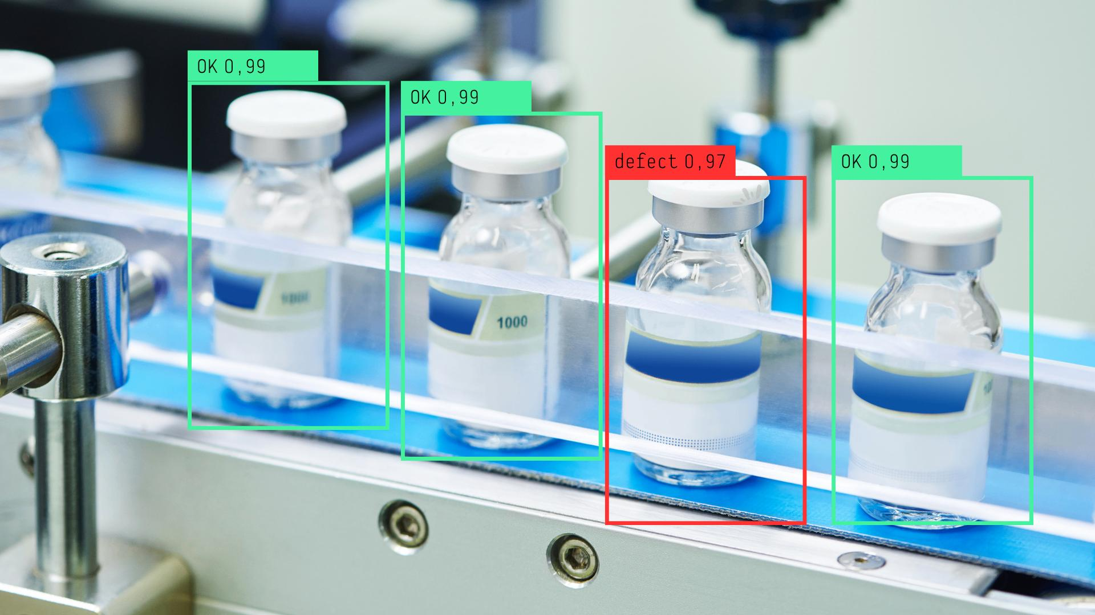
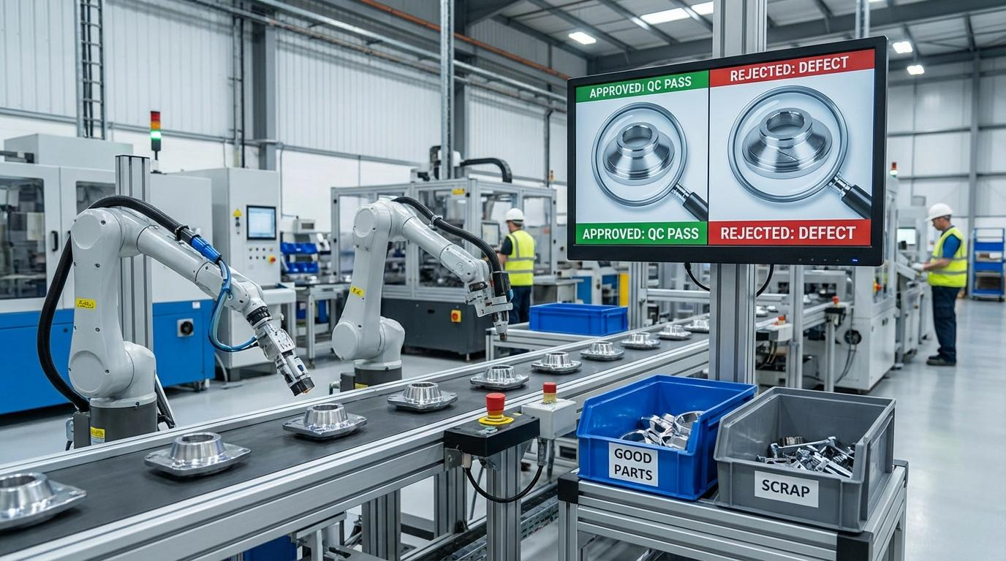
AUTOMATED DECISION & INTELLIGENT MANUFACTURING
AUTOMATED DECISION-MAKING
After classification, the system automatically decides whether the product is acceptable.
✅ PASS
No defect detected
→ Product continues production
❌ FAIL
Defect detected
→ Product rejected / operator alerted
Benefits
Faster inspection
Consistent quality
Reduced manual effort
Early defect detection
Real-time quality monitoring
Supports intelligent manufacturing

Slide 12


